Slide 1
Building Programming Language Infrastructure with LLVM Components
Sunho Kim, Vassil Vassilev, and Lang Hames

Slide 2
First steps
What you’ll need
A build machine (a high end laptop or desktop should do)
git for version control (LLVM is hosted on GitHub)
cmake for configuring the build system
ninja for building (much faster than make!)
clang, gcc, or MSVC for compiling
lld preferred for linking on Linux (binutils ld works, but is slow)
Your trusty command line interface and editor
Notes:
Diving right in. Today we’re going to be working with the LLVM project, and LLVM can take quite a while to build. So we want to get LLVM building first, then while that’s happening we’ll take some time to describe what it actually is.
You don’t necessarily have to code along with the workshop today: all the material is public, so you should be able to revisit a lot of this later, however we encourage you to follow along if you can.
You’ll need a decent build machine. Higher end laptops and desktops should do well. Machines with limited memory and processing power are going to struggle. The whole tutorial is designed to be done in a terminal, so if you have a more powerful machine that you can remote-desktop or ssh into then that’ll work just fine. If you’re using ssh just remember to start a tmux or screen session so that you don’t kill your build every time your laptop goes to sleep. :)
In terms of software you’ll need git for version control — LLVM is hosted on GitHub. LLVM uses CMake to configure the build system, so you’ll need that to. You can use CMake to generate makefiles if you want, but using the ninja build program is encouraged — it’s significantly faster than make. (It may seem like a hassle to install it if you don’t have it already, but trust me: you’ll make back that time and more when you’re building LLVM). To compile you’ll need C and C++ compilers. LLVM supports recent versions of Clang, GCC, or MSVC. Finally, if you’re on Linux I’d recommend installing lld or ld.gold if you haven’t already to speed up the link step. The default ld that you get from binutils will work, but it takes a lot more memory and a lot longer. On memory constrained Linux machines lld can be the difference between being able to build LLVM and not being able to.
Finally you’ll need your trusty terminal and editor.
Who has all this already? Does anyone not? I’m going to leave this slide up for a minute. Please put up your hand if you’re not sure how to set any part of this up and we can try to help you out.

Slide 3
First steps
Checking out LLVM
Check out llvm-project from github: % git clone https://github.com/llvm/llvm-project.git
Set up a build directory: % cd llvm-project % mkdir build % cd build
Notes:
Ok. Next up we’re going to check out LLVM from GitHub and create a build directory.

Slide 4
First steps
Configuring LLVM
% cmake \ -GNinja \
-DCMAKE_BUILD_TYPE=RelWithDebInfo \
-DLLVM_ENABLE_PROJECTS=“clang” \
-DLLVM_ENABLE_RUNTIMES=“compiler-rt” \
-DLLVM_TARGETS_TO_BUILD=“AArch64;X86;NVPTX” \
-DLLVM_PARALLEL_LINK_JOBS=1 \
/path/to/llvm-project/llvm
Notes:
Now we’re going to configure the LLVM build system using CMake. We do this by passing options to CMake.
First up is the generator. If you’ve installed ninja then you’ll pass the -GNinja option to generate ninja build files. If you’re sticking with Make you can omit this line.
Next up you need to decide what kind of build you want — Release and Debug are the two big options, but there are others (e.g. Release with Debug Info). LLVM developers seem to be split on which one you should use for work day to day. I like a Debug build because I like to be able to dive into my debugger at any time, but debug builds are typically slower (especially when you bootstrap the compiler runtime, which we’ll be doing). Release builds are faster, but if you do want to debug you have to stop and do a debug build. Whatever you choose you’ll find yourself using the other style from time to time as needed, so don’t stress too much about the choice up-front. If you’re not sure then just go for Debug.
Next we’re going to tell CMake what projects we want to build. The llvm-project umbrella contains a lot projects within it, which we’ll talk about in a minute. For now we want to build the clang front-end and LLVM itself. We don’t have to specify LLVM — it’s built implicitly if you build clang. Next we’re going to request compiler-rt to be built. We need this for some advanced features of LLVM’s JIT. Compiler-rt will be built with the built compiler, not the system compiler — this is where debug builds can get a bit slow.
To save ourselves a little time we’re going to tell LLVM to only build target support for a couple of architectures: AArch64 and X86. This should cover all the machines in use here today. Is there anyone using a machine that’s not x86-64 or AArch64? If so you can just omit this line and build all the backends. Finally we give CMake the path to llvm-project/llvm directory. This is where CMake will take its config files from. Hit enter and CMake will do its thing — this make take a few minutes. Now if you get any errors from CMake please put up your hand and one of us can come and help you get everything configured. I’ll wait a minute while everyone’s configs are happening, then we’ll move on.

Slide 5
First Steps
Building LLVM
% ninja clang clang-repl opt
Notes:
Ok — we’re all configured, now we build. This step is easy. You just run ninja (or make, if you’re using that).
Has everyone’s build started?
Great. Now if your build starts throwing up errors please raise your hand and one of us can come and help you. Don’t be shy about this — we really want to help you get up and running.
For now, lets move on and look at what it is that we just started building…

Slide 6
The LLVM Project
Workshop Material
LLVM Website: https://llvm.org
Clang Website: https://clang.llvm.org
LLVM C++ APIs change over time, but in-tree tutorial code is kept up-to-date
Check LLVM docs, examples, and tutorial code for the latest versions
The LLVM forums and LLVM discord are great places to go with questions
Notes:
We want to make sure that attendees can revisit this in the future.

Slide 7
The LLVM Project
What is it?
Libraries for building programming language tools
Optimizers, code generators, assemblers, runtimes and standard libraries, debuggers, linkers, language frontends, JIT APIs, …
Centered on the LLVM IR (intermediate representation)
Notes:
Very briefly introduce the LLVM project and the relevant points on LLVM IR.

Slide 8
The LLVM Project
LLVM IRs
LLVM’s target-independent “virtual instruction set”
Generic, low-level, typed, SSA-form IR suitable as a target for front-ends
LLVM user writes codegen that emits LLVM IRs
LLVM’s optimizer and back-end operate on input IRs to generate efficient machine code specific to the target architecture
Notes:
Very briefly introduce the LLVM project and the relevant points on LLVM IR.

Slide 9
LLVM IR
Benefits
X86
C++
AArch64
LLVM
Rust
LLVM
IR
RISC-V
Swift
NVPTX
(Your language)
AMDGPU
Notes:
Very briefly introduce the LLVM project and the relevant points on LLVM IR.

Slide 10
LLVM Pipeline
Overview
Source Code
Frontend
AST
LLVM IR (.ll)
LLVM optimizer
LLVM Backend
SelectionDAG
LLVM MachineIR
LLVM MC (Assembly)
Object file (.o)
LLD (or other linker)
Executable
Notes:
Very briefly introduce the LLVM project and the relevant points on LLVM IR.

Slide 11
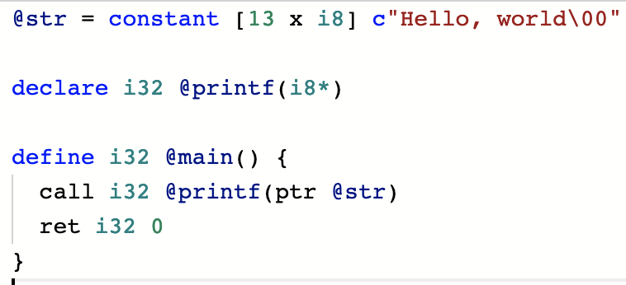
LLVM IR
Hello, world!
% clang -o helloworld main.ll
Notes:
Very briefly introduce the LLVM project and the relevant points on LLVM IR.

Slide 12
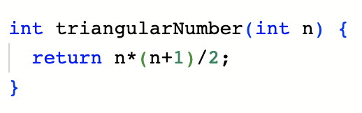
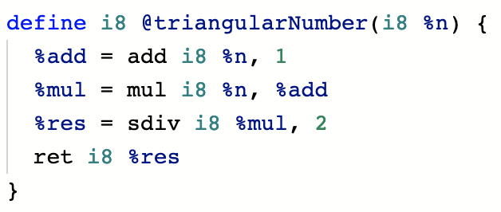
LLVM IR
Example LLVM IR program
Function
// %add = n+1
Instruction
// %mul = n * %add
// %res = %mul / 2
// return %res
SSA: once you assign, you can’t change later (e.g. you can’t assign to %add another time)
Explicit types: type must be specified everywhere
Notes:
Very briefly introduce the LLVM project and the relevant points on LLVM IR.

Slide 13
LLVM IR
Module
Top-level structure in LLVM
Translation unit equivalent (each module can be compiled to individual .o file)
Global values: functions and global variables
main.ll
Global variables
Function declarations
Function definitions
Type declarations
Notes:
Very briefly introduce the LLVM project and the relevant points on LLVM IR.

Slide 14
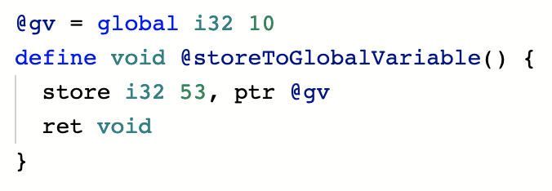
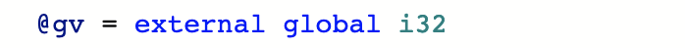
LLVM IR
Global variable
main.ll
extern int gv
.elf
Linker
.exe
gv.ll
% clang main.ll gv.ll
Notes:
Very briefly introduce the LLVM project and the relevant points on LLVM IR.

Slide 15
LLVM IR
Basic blocks
How to represent this code in LLVM IR?
int fib(int n) { if (n <= 1) return n;
return fib(n-1) + fib(n-2);
}
LLVM don’t have “if statement” syntax
Notes:
Very briefly introduce the LLVM project and the relevant points on LLVM IR.

Slide 16
LLVM IR
Basic blocks
Basic building blocks of functions
Block of instructions that ends with “terminal” instruction which is either branch or return
Module
Function
Basic Block
Instruction
Instruction
Notes:
Very briefly introduce the LLVM project and the relevant points on LLVM IR.

Slide 17
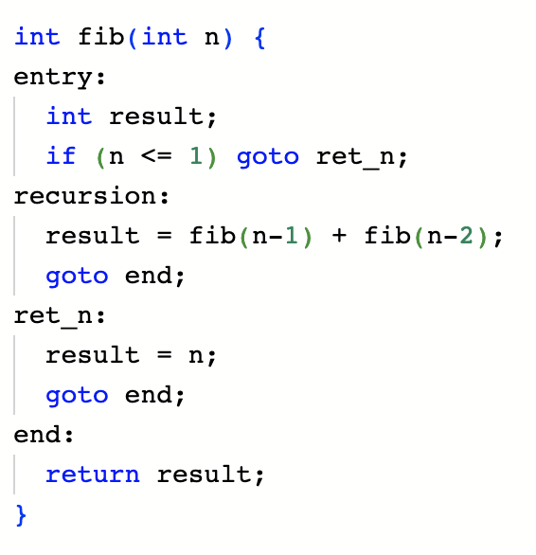
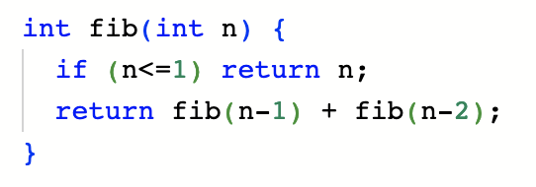
LLVM IR
Basic blocks
N>1
N<=1
Forms a directed graph of code blocks
Within a single basic block, control flow is completely linear
Notes:
Very briefly introduce the LLVM project and the relevant points on LLVM IR.

Slide 18
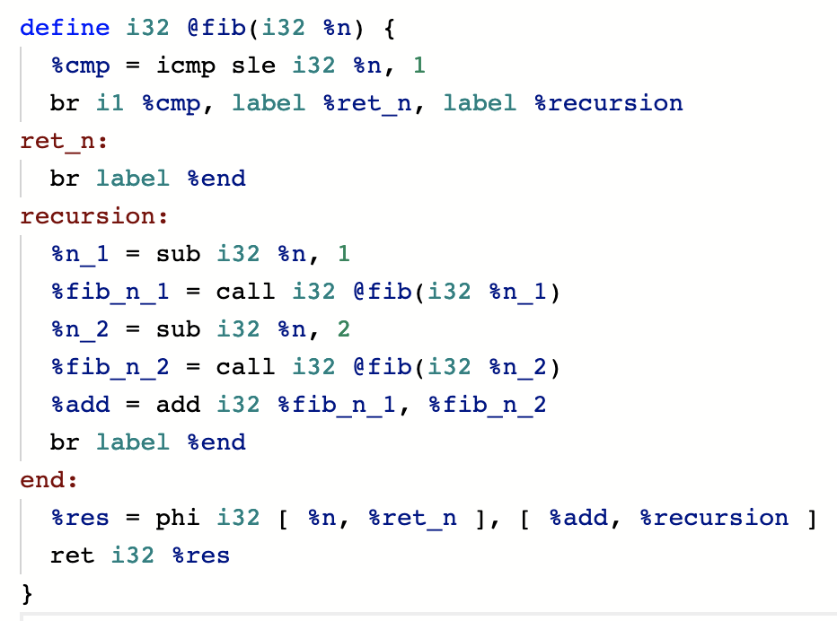
LLVM IR
Fibonacci example
// %cmp = n <= 1
// jump to %ret_n if %cmp else %recursion
// jump to %end
// %fib_n_1 = fib(n - 1)
// %fib_n_2 = fib(n - 2)
// %add = %fib_n_1 + %fib_n_2
// jump to %end
{
%n if previous block was %ret_n
%res =
// return %res
%add if previous block was %recursion
Notes:
Very briefly introduce the LLVM project and the relevant points on LLVM IR.

Slide 19
LLVM IR
Tips
Use clang to understand how idiomatic LLVM IR programs are structured and written
clang -emit-llvm main.cpp
godbolt.com is our friend
Hover over a line of c++ source code, it will highlight corresponding part of LLVM IR program
Notes:
Very briefly introduce the LLVM project and the relevant points on LLVM IR.

Slide 20
LLVM IR Optimization
LLVM does its major optimizations on IR level; they optimize input IRs into more efficient one
The power behind super efficient binary code generated by LLVM
To name a few: constant folding, loop unrolling, dead code elimination, mem2reg, loop vectorization, …

Slide 21
LLVM Passes and Analyses
LLVM IR to IR transforms are called Passes
Write your own passes to implement optimizations or analysis
See LLVM doc “Using the New Pass Manager”

Slide 22
LLVM IR Pass Example
Optimize FFT
Fast Fourier Transform (FFT): a powerful algorithm that can be used to do convolution operation within O(N log N) time
Applications: signal processing, fast image blur filter, polynomial multiplication, convolutional neural network, …

Slide 23
LLVM IR Pass Example
Optimize FFT
One of FFT implementations: Number Theoretic Transform (NTT)
Uses primitive root of unity modulo as basis for FFT
In nutshell, it just uses tons of modulo operations (a % mod)
But, modulo operation is slow in cpu
NTT can be made about 1.75 times faster by optimizing modulo operations

Slide 24
LLVM IR Pass Example
Optimize FFT
Modular arithmetics
a+b
becomes
(a+b) % MOD
a*b
becomes
(a*b) % MOD
Integers keep in the range [0,MOD) -> a and b also in range [0,MOD)

Slide 25
LLVM IR Pass Example
Optimize FFT
Modular addition optimization
(a+b) % 3
a: [0,3)
b: [0,3)
a+b: [0,6)
a+b | 0 | 1 | 2 | 3 | 4 | 5
(a+b)%3 | 0 | 1 | 2 | 0 | 1 | 2
= a+b-3
If a+b >= 3, subtract 3

Slide 26
LLVM IR Pass Example
Optimize FFT
Modular addition optimization
if (a+b >= MOD)
a+b-MOD
else
a+b
(a+b) % MOD

Slide 27
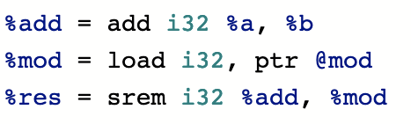
LLVM IR Pass Example
Optimize FFT
(a+b) % MOD
SREM
ADD
A
B
MOD

Slide 28
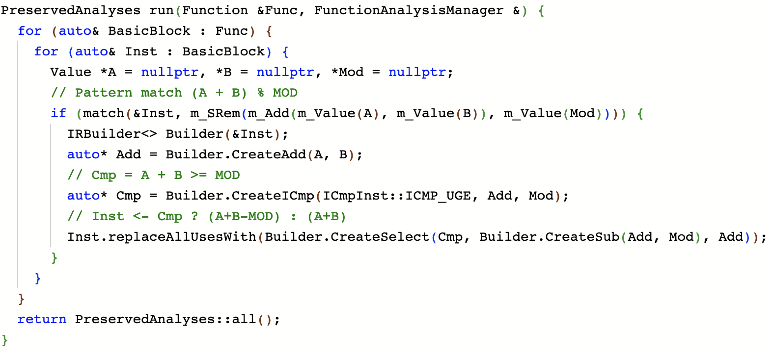
LLVM IR Pass Example
Optimize FFT
SREM
ADD
A
B
MOD

Slide 29
LLVM IR Pass Example
Optimize FFT
Alive 2 for IR transform verification
https://alive2.llvm.org/ce/
Actually run IRs to verify transform doesn’t change the behavior
https://reviews.llvm.org/D152568
Built to battle undefined behavior such as integer overflow
e.g. verify transform doesn’t introduce additional UB

Slide 30
LLVM Backend
Transform LLVM IR to actual machine code
Has intermediate representations called SelectionDAG and MInst
Uses TableGen language to pattern match DAG pattern and “lower” it to machine instructions
Heuristic weight is given to patterns in order to select optimal instructions (e.g. select SIMD instruction when possible)
It does its own instruction combine transforms in SelectionDAG level

Slide 31
LLVM JIT API
Source Code
Frontend
LLVM IR (.ll)
LLVM optimizer
LLVM Backend
SelectionDAG
MIR
Assembly (.S)
Object file (.o)
LLD (or other linker)
Executable file

Slide 32
LLVM JIT API
Source Code
Frontend
LLVM IR (.ll)
LLVM optimizer
LLVM Backend
SelectionDAG
MIR
Assembly (.S)
Object file (.o)
LLVM ORC API
Executable memory buffer

Slide 34
LLVM JIT APIs
Notes:
Ok — let’s talk about LLVM’s JIT APIs in a bit more detail.

Slide 35
Today’s Workshop
We’re going to build a Read-Eval-Print Loop (REPL) for Kaleidoscope
Kaleidoscope is a simple procedural language used in the LLVM tutorials: def fib(n) if n < 3 then 1 else fib(n - 1) + fib(n - 2)
We’ll take the language for granted and focus on the JIT implementation
We’re going to start out eagerly compiling, and make it progressively lazier

Slide 36
Related materials
LLVM Kaleidoscope tutorial series
LLVM Example programs
LLVM Documentation
LLVM Developer Meeting Talks
2018 — Updating ORC JIT for concurrency (ORCv2, which we’ll use today)
2021 — ORC deep-dive, covering JITLink & the ORC runtime
2016 — Original ORC introduction (mostly outdated)
Notes:
The aim today is to get some simple hands-on experience with these APIs, but there’s a lot more material out there if you want to go beyond what we’ll look at today.
There’s the LLVM Kaleidoscope tutorial series. This describes how to implement the Kaleidoscope language on top of LLVM, and there’s a companion series that shows you how to build a JIT for Kaleidoscope. The workshop today is adapted from that second series.
There are a bunch of example programs included in the LLVM repository under llvm/examples that show you how to do different, specific things with the JIT APIs, including things that we won’t have time to cover today.
There’s the LLVM documentation (mostly up to date) in the llvm/docs directory. That includes documents describing the ORC APIs that we’ll look at today.
Finally there are some talks that were given at previous LLVM Developer Meetings. There was a talk in 2018 called “Updating ORC JIT for concurrency” which introduced the APIs that we’ll look at today. There was a 2021 deep dive into the JIT linker and ORC runtime components — we’ll touch on those in this workshop, but that’s a great place to get the full story on them.
Finally if you’re searching around on YouTube you’ll probably come across the original 2016 talk that introduced the ORC APIs — that one is mostly outdated at this point.

Slide 37
ORC — On Request Compilation
LLVM’s “JIT” APIs
A library for building JITs and JIT-like things
Contains a Just-In-Time Linker that can patch in relocatable object files
Makes it easy to plug in your own compiler(s)
Supports lazy compilation, concurrent compilation, and remote execution
Directly inspect and modify JIT’d machine code
Construct programs by combining compiler inputs (rather than linking compiler outputs), then let ORC trigger compilations as needed
Notes:
ORC is a library for building JITs and JIT-link things — environments where you can link new executable code into a process at runtime.
To support this ORC contains a Just-In-Time linker, which lets it patch in relocatable object files, which are the output format for static compilers.
This makes it easy to plug your own compilers into ORC, and adapt your existing static compiler for use in JIT contexts. It also makes it easy to mix multiple languages in a single JIT’d program by plugging in multiple compilers.
ORC supports lazy compilation — you can defer function compilation until a given function is called. It supports concurrent compilation, even where program representations that are being compiled concurrently depend on one another. ORC will discover and manage those interdependent compiles to make everything work. Finally it supports remote execution: You can have the JIT’d code run in your own process, or in a separate process. The separate process can be on a different machine, running a different architecture and OS — that’s all supported. The origin of this out-of-process execution feature is debugger expression evaluation: the LLDB debugger compiles test expressions in the debugger process, but runs them in the process being debugged, and it needed to be able to support debugging of embedded systems, so we made sure that the JIT could support this. It’s handy for embedded systems development, but also very useful for stability and security — you can isolate the JIT from JIT’d code and prevent crashes in one from taking down the other, and can apply different security policies to JIT’d code. For example you can take away the ability to create new executable code from the process running the JIT’d code. This mitigates a lot of attacks against JIT compilers.
ORC lets you directly inspect and modify JIT’d code as it flows through the JIT linker, which we’ll take a look at today. This gives you a lot of control over the low level details of how the JIT works. For example you’re not constrained to use stub functions to implement lazy compilation, you can install a plugin into the JIT linker and rewrite instruction streams to update call sites when you change the address of a function.
And ORC’s model for constructing programs is designed to be both easy to use, and applicable to a wide range of projects. The idea is that you construct JIT’d programs by combining compiler inputs, rather than linking compiler outputs, then you let ORC run the compiles as needed. All of the linking rules are the same, they’re just deferred until runtime, so the program should behave the same way that it would have if you had compiled it up-front.

Slide 38
Kaleidoscope
Exercises
Basic REPL loop, Kaleidoscope compiled up-front
Defer compilation until first lookup using a custom MaterializationUnit
Defer lookup until runtime using lazy re-exports
Make precompiled symbols accessible to JIT’d code
Use ObjectLinkingLayer::Plugin to access JIT’d objects during linking

Slide 39
Workshop Code
Checking out, configuring, and building the example code
% git clone https://github.com/compiler-research/pldi-tutorials-2023.git
% cd pldi-tutorials-2023
% mkdir build && cd build
% cmake -GNinja -DCMAKE_BUILD_TYPE=Debug \ -DLLVM_DIR=/path/to/llvm-build \ ..
% ninja

Slide 40
Workshop Code
Checking out, configuring, and building the example code
% git clone https://github.com/compiler-research/pldi-tutorials-2023.git
% cd pldi-tutorials-2023
% mkdir build && cd build
% cmake -GNinja -DCMAKE_BUILD_TYPE=Debug \ -DLLVM_DIR=/path/to/llvm-build/lib/cmake/llvm \ ..
% ninja

Slide 41
Kaleidoscope.h
Parser and JIT Definition

Slide 42
Kaleidoscope.h
Overview
Kaleidoscope FunctionAST definition
Just a pair of PrototypeAST + ExprAST
Kaleidoscope functions are compile units for the purpose of this tutorial
KaleidoscopeParser — Incremental Kaleidoscope parser
parse — Translate source to FunctionAST [ + expression name ]
codegen — Compile FunctionAST to llvm::ThreadSafeModule

Slide 43
Kaleidoscope.h
KaleidoscopeJIT — member variables
ExecutionSession — Top-level management for ORC programs
Create JITDylibs, manage JIT’d resources, perform symbol lookup
DataLayout — LLVM IR data lowering: endianness, alignment, mangling
Mangler — Map C/IR symbol names to linker-level names suitable for lookup

Slide 44
ORC APIs
ORC uses linker-mangled symbol names
What are linker-mangled names?
E.g. on Darwin, C void foo(void) becomes assembly symbol _foo
Why use linker-mangled names in a JIT?
Consistency with existing compilers and compiled code

Slide 45
Kaleidoscope.h
KaleidoscopeJIT — member variables
ExecutionSession — Top-level management for ORC programs
Create JITDylibs, manage JIT’d resources, perform symbol lookup
DataLayout — LLVM IR data lowering: endianness, alignment, mangling
Mangler — Map C/IR symbol names to linker-level names suitable for lookup
ObjectLinkingLayer — Links relocatable object files
IRCompileLayer — Compile LLVM IR to relocatable object files
JITDylib — The program representation container

Slide 46
Kaleidoscope.h
KaleidoscopeJIT — methods
Create tries to create members, bails out on error
ExecutorProcessControl abstracts the target process (in this case the current process) — it’s owned by ExecutionSession
JITTargetMachineBuilder builds llvm::TargetMachine instances for LLVM IR compilation
~KaleidoscopeJIT destructor calls ExecutionSession::endSession
Releases JIT’d resources
KaleidoscopeJIT constructor is trivial — just sets member variables

Slide 47
Exercise 1
Simple REPL, Eager Compilation

Slide 48
Exercise 1
Includes
This workshop
#include "Kaleidoscope.h"
#include "llvm/LineEditor/LineEditor.h" #include "llvm/Support/InitLLVM.h" #include "llvm/Support/TargetSelect.h"
LLVM Line Editor,
LLVM Initialization,
and Target Initialization

Slide 49
Exercise 1
Initialization
int main(int argc, char *argv[]) {
InitLLVM X(argc, argv);
InitializeNativeTarget(); InitializeNativeTargetAsmPrinter(); InitializeNativeTargetAsmParser();
ExitOnError ExitOnErr("kaleidoscope: ");
Initialize LLVM, initialize native target, create ExitOnErr

Slide 50
Exercise 1
JIT, Parser, and REPL setup
JIT
std::unique_ptr<KaleidoscopeJIT> J = ExitOnErr(KaleidoscopeJIT::Create());
KaleidoscopeParser P;
llvm::LineEditor LE("kaleidoscope-repl");
while (auto Line = LE.readLine()) {
auto ParseResult = P.parse(*Line);
if (!ParseResult) continue;
…
Parser
Parse Input to Kaleidoscope AST

Slide 51
Exercise 1
Compile Kaleidoscope AST to LLVM IR, add to JIT
auto IRMod = P.codegen(std::move(ParseResult->FnAST), J->DL);
if (!IRMod) continue;
ExitOnErr( J->CompileLayer.add(J->MainJD, std::move(*IRMod)));
Generate LLVM IR Module from Function AST
Add IR Module to the JIT

Slide 52
Exercise 1
Check for top-level expression, lookup
Lookup triggers LLVM IR compilation
if (ParseResult—>TopLevelExpr.empty()) continue;
Expected<ExecutorSymbolDef> ExprSym = J->ES->lookup(
&J->MainJD, J->Mangle(ParseResult->TopLevelExpr));
if (!ExprSym) { errs() << "Error: " << toString(ExprSym.takeError()) << "\n"; continue; }
Print errors and continue

Slide 53
Exercise 1
Cast expression address to pointer, execute
double (*Expr)() = ExprSym->getAddress().toPtr<double (*)()>();
double Result = Expr();
outs() << "Result = " << Result << "\n";
Cast compiled address to pointer
Call JIT’d code

Slide 54
Exercise 1
First JIT’d Kaleidoscope code
% ./bin/p2-ex1
kaleidoscope> def add(a b) a + b;
kaleidoscope> add(1, 2);
Result = 3.000000e+00

Slide 55
Try un-commenting:
// dbgs() << "Compiling " << ParseResult->FnAST->getName() << "\n";
auto IRMod = P.codegen(std::move(ParseResult->FnAST), J->DL);

Slide 56
Exercise 1
First JIT’d Kaleidoscope code (with debugging output)
% ./bin/p2-ex1
kaleidoscope> def add(a b) a + b;
Compiling add
kaleidoscope> add(1, 2);
Compiling expr.0
Result = 3.000000e+00

Slide 57
Exercise 2
Wrapping Kaleidoscope ASTs

Slide 58
Exercise 2
Wrapping custom program representations
Subclass MaterializationUnit to wrap custom program representations
Construct with linker-level interface that would be produced if compiled
Implement materialize method — called if lookup matches interface
Implement discard method — called if interface symbol is overridden

Slide 59
Exercise 2
MaterializationResponsibility
materialize will be passed a MaterializationResponsibility object
Initially responsible for materializing all symbols, even if only some requested
To continue materializing all symbols just pass the object along, otherwise…
Use getRequestedSymbols to identify the symbols that are actually needed
Partition program representation, return unrequested symbol with replace
Continue materialization with requested symbols
See 2018 LLVM Developer Meeting JIT talk for more details

Slide 60
Exercise 2
Subclass MaterializationUnit
Subclass MaterializationUnit
class KaleidoscopeASTMU : public MaterializationUnit { public:
KaleidoscopeASTMU(KaleidoscopeParser &P, KaleidoscopeJIT &J, std::unique_ptr<FunctionAST> FnAST)
: MaterializationUnit(getInterface(J, *FnAST)),
P(P), J(J), FnAST(std::move(FnAST)) {}

Slide 61
Exercise 2
The materialize method
Responsibility Object
void materialize( std::unique_ptr<MaterializationResponsibility> R) {
if (auto IRMod = P.codegen(std::move(FnAST), J.DL)) J.CompileLayer.emit(std::move(R), std::move(*IRMod));
else R->failMaterialization(); }
On success, pass IRMod and Responsibility object along to CompileLayer
If something goes wrong we must explicitly report it

Slide 62
Exercise 2
Constructing the interface
static MaterializationUnit::Interface getInterface(KaleidoscopeJIT &J, FunctionAST &FnAST) {
SymbolFlagsMap Symbols;
Symbols[J.Mangle(FnAST.getName())] = JITSymbolFlags::Exported | JITSymbolFlags::Callable;
return { std::move(Symbols), nullptr }; }
Map symbol name to flags
Return flags map (and initializer symbol, always null in our case)

Slide 63
Exercise 2
Old approach: Eagerly compile, add LLVM IR
dbgs() << "Compiling " << ParseResult->FnAST->getName()
<< "\n";
auto IRMod = P.codegen(std::move(ParseResult->FnAST), J->DL); … ExitOnErr( J->CompileLayer.add(J->MainJD, std::move(*IRMod)));

Slide 64
Exercise 2
New approach: add ASTs
ExitOnErr(J->MainJD.define(
std::make_unique<KaleidoscopeASTMU>( P, *J, std::move(PR->FnAST))));

Slide 65
Try un-commenting:
// dbgs() << "Compiling " << ParseResult->FnAST->getName() << "\n";
if (auto IRMod = P.codegen(std::move(ParseResult->FnAST), J->DL))…

Slide 66
Exercise 2
Getting lazier…
% ./bin/p2-ex2
kaleidoscope> def neg(x) 0 - x;
kaleidoscope> def abs(x) if x < 0 then neg(x) else x;
kaleidoscope> abs(3);
Compiling expr.0
Compiling abs
Compiling neg
Result = 3.000000e+00

Slide 67
Exercise 3
Lazy re-exports

Slide 68
Exercise 3
Lazy compilation using lazy re-exports
Create lazy re-exports from a map of stub names to function body names
ORC generates the stubs for you
E.g. for "fn" → "fn$impl":
call
jump
caller
fn
__orc_rt_resolve
jump
return
lookup
fn$impl:
50f20f10050700…
compile
fn$impl
def fn$impl(x) x + 1

Slide 69
Exercise 3
Lazy compilation using lazy re-exports
Create lazy re-exports from a map of stub names to function body names
ORC generates the stubs for you
E.g. for "fn" → “fn$impl":
call
caller
fn
After first call the stub jumps directly to the compiled body
return
jump
fn$impl:
50f20f10050700…

Slide 70
Exercise 3
Lazy re-exports initialization
auto EPCIU = ExitOnErr(EPCIndirectionUtils::Create(*J->ES));
auto EPCIUCleanup = make_scope_exit([&]() { if (auto Err = EPCIU->cleanup()) J->ES->reportError(std::move(Err)); });
auto &LCTM = EPCIU->createLazyCallThroughManager(*J->ES, ExecutorAddr::fromPtr(&handleLazyCompileFailure));
ExitOnErr(setUpInProcessLCTMReentryViaEPCIU(*EPCIU));
auto ISM = EPCIU->createIndirectStubsManager();
BOILERPLATE !

Slide 71
Exercise 3
Create re-exports map, rename function body
std::string FnImplName = PR->FnAST->getName() + "$impl";
SymbolAliasMap ReExports({
{ J->Mangle(PR->FnAST->getName()),
{ J->Mangle(FnImplName),
JITSymbolFlags::Exported | JITSymbolFlags::Callable } } });
PR->FnAST->setName(std::move(FnImplName));

Slide 72
Exercise 3
Add function body and lazy reexports to JIT
ExitOnErr(J->MainJD.define( std::make_unique<KaleidoscopeASTMU>( P, *J, std::move(PR->FnAST))));
ExitOnErr(J->MainJD.define(
lazyReexports(LCTM, *ISM, J->MainJD, std::move(ReExports))));
Add fn$impl definition
Defines fn stub, which will lookup and run fn$impl if called

Slide 73
Exercise 3
Lazy compilation using lazy re-exports
In Exercise 2 we deferred AST compilation until lookup
In this exercise we deferred lookup of the function body until runtime
Together they defer compilation of the function body until runtime
Custom MaterializationUnit + lazyReexports provides lazy compilation for arbitrary program representations
Lookup is thread-safe — by building laziness on top of it we inherit that safety

Slide 74
Exercise 3
Laziest…
% ./bin/p2-ex3
kaleidoscope> def neg(x) 0 - x;
kaleidoscope> def abs(x) if x < 0 then neg(x) else x;
kaleidoscope> abs(3);
Compiling expr.0$impl
Compiling abs$impl
Result = 3.000000e+00
kaleidoscope> abs(0 - 3);
Compiling expr.1$impl
Compiling neg$impl
Result = 3.000000e+00

Slide 75
Exercise 4
Reflecting Precompiled Symbols

Slide 76
Exercise 4
Reflecting Precompiled Symbols
We’ll use a DefinitionGenerator to add symbols in response to lookups
Generators are attached to JITDylibs
Lookups that don’t match existing symbols will fall through to generators
Generator for this exercise uses dlsym / GetProcAddress under the hood
Generators have high overhead — avoid if possible, use sparingly
To expose a fixed set of precompiled symbols use absoluteSymbols instead: it’s faster, and prevents unintended symbols from being pulled in

Slide 77
Exercise 4
Create and link against a “process-symbols” JITDylib
Create JITDylib to hold process symbols
auto &ProcessSymbolsJD = J->ES->createBareJITDylib("<Process_Symbols>");
ProcessSymbolsJD.addGenerator(ExitOnErr(
EPCDynamicLibrarySearchGenerator:: GetForTargetProcess(*J->ES)));
J->MainJD.addToLinkOrder(ProcessSymbolsJD);
Add a Process Symbols Generator
Link MainJD against Process Symbols JITDylib

Slide 78
Exercise 4
Add a precompiled function
extern "C" double circleArea(double radius) { return M_PI * radius * radius; }
extern “C” gives us C / IR names, which line up with Kaleidoscope

Slide 79
Exercise 4
Use from Kaleidoscope
% ./bin/p2-ex4
kaleidoscope> extern circleArea(r);
kaleidoscope> def cylinderVolume(r h) circleArea(r) * h
kaleidoscope> cylinderVolume(1, 2);
Result = 6.283185e+00

Slide 80
Exercise 5
Object Linking Layer Plugins

Slide 81
Exercise 5
The JIT Linker
JITLink links relocatable object files directly into memory
It has a public API and core data structure — the LinkGraph
You can install custom plugins to inspect / mutate LinkGraphs during linking
Plugins can add passes to the linker pipeline in specific phases: before pruning, before and after allocation, and before and after fixups
Passes can inspect / mutate sections, symbols, and relocations (subject to the rules of the phase they run in)
See the LLVM 2021 ORC Deep-dive talk on YouTube for more info

Slide 82
Exercise 5
Custom Plugin Class
class MyPlugin : public ObjectLinkingLayer::Plugin {
public: void modifyPassConfig( MaterializationResponsibility &MR, LinkGraph &G, PassConfiguration &PassConfig) override {
PassConfig.PostAllocationPasses.push_back( [this](LinkGraph &G) { return printGraph(G); });
} …

Slide 83
Exercise 5
The printGraph pass
Error printGraph(LinkGraph &G) {
// Print graph name: outs() << "Graph " << G.getName() << "\n";
// Loop over sections for (auto &Sec : G.sections()) { outs() << " Section " << Sec.getName() << ", " << Sec.getMemProt() << "\n"; …

Slide 84
Exercise 5
Demo
% ./bin/p2-ex5
kaleidoscope> extern circleArea(r);
kaleidoscope> circleArea(1);
Graph m.0-jitted-objectbuffer
Section __TEXT,__text, R-X
Symbols: 0x10dd54000: _expr.0$impl
Blocks: 0x10dd54000: content = { 0x50 0xf2 0x0f 0x10 0x05 0x07 0x00 0x00 0x00 0xe8 ... }, 16-bytes, 4 edges … Result = 3.141593e+00

Slide 85
Exercise 5
What is this good for?
ORC uses it to discover initializers, implement exceptions and TLV, etc.
Apply range-based optimizations to instruction streams (on by default)
Fine-grained control over the implementation of lazy control flow, e.g. …
Record and rewrite call-sites to bypass stub functions
Insert nop-sleds at the start of functions
Insert some instrumentation and logging without polluting compiled objects

Slide 86
Further topics

Slide 87
Reoptimization
Tiering up generated code performance
Fast compile up-front at low optimization level
Recompile hot functions at a higher optimization level
ORC’s symbol lookup system makes this easy to express in a cross-platform and thread safe way
Initial work is happening as part of this year’s Google Summer of Code

Slide 88
Speculation
Sometimes it pays to be a little less lazy
If we wait until we hit a stub then execution of JIT’d code blocks on compiles
Some function executions can be guessed at in advance
Use program analysis, or profile data, or both
If we have free resources then kick compiles off early (it just takes a lookup)
When we speculate effectively we should be able to hide compile latency
Identifying good quality speculation opportunities is an open problem in LLVM

Slide 89
Further, further topics
There is a lot we couldn’t cover today
JIT Linker developments (new backends, optimizations)
The ORC runtime (dlopen emulation)
Remote execution
Debugger and profiling support for JIT’d code
…
For background check out LLVM tutorials, examples, Dev Talks, etc.
For open problems check out LLVM GitHub issues
Join the LLVM community discourse forums and discord channel

Slide 90
Questions?

Slide 92
Part 3. Compiler-As-A-Service
How to use Clang as a library. Incremental compilation. How to build a C++ interpreter. C/C++/Python on-demand interoperability.
Vassil Vassilev

Slide 93
The Clang Project
What is it?
Clang is a compiler which supports C, C++, Objective-C, and Objective-C++ programming languages, as well as the OpenMP, OpenCL, RenderScript, CUDA, SYCL, and HIP frameworks.
Just like LLVM, Clang is built by a set of reusable components and can be used as a library.
Analysis
Basic
Lex
Sema
Driver
Format
FrontendTool
Interpreter
...
AST
CodeGen
Parse
Index
Edit
Frontend
StaticAnalyzer
Tooling

Slide 94
Going Beyond Kaleidoscope
The Clang Compiler Infrastructure. Classic Data Flow
Clang takes input pipes it through a frontend and a backend and produces machine code
C
C++
Lex
Parse
Sema
AST
CodeGen
IR
LLVM
...
CUDA
Frontend
Backend
OpenCL

Slide 95
Exercise 1
Using Clang As A Library
AST
Tooling

Slide 96
Exercise 1
p3-ex1.cpp: Extracting documentation from source
Run the compiler on given code.
#include "clang/AST/Comment.h"
#include "clang/AST/DeclTemplate.h"
#include "clang/Tooling/Tooling.h"
...
auto ASTU = tooling::buildASTFromCodeWithArgs(Code);
ASTContext &C = ASTU->getASTContext();
TranslationUnitDecl* TU = C.getTranslationUnitDecl();
TU->dump();
|-ClassTemplateDecl 0x7f83db895f48 <input.cc:4:1, line:5:40> col:8 ComplexNumber
| |-TemplateTypeParmDecl 0x7f83db895dd0 <line:4:10, col:19> col:19
| |-CXXRecordDecl 0x7f83db895e98 <line:5:1, col:40> col:8 struct ComplexNumber
| | ...
| | |-FullComment 0x7f83dc00c200 <line:2:4, col:52>
| | | `-ParagraphComment 0x7f83dc00c1d0 <col:4, col:52>
| | | `-TextComment 0x7f83dc00c1a0 <col:4, col:52> Text=" This is the documentation for the ComplexNumber."

Slide 97
Exercise 2
A Simple C++ REPL
Frontend
Interpreter

Slide 98
Exercise 2
Incremental Compilation in Clang
We can split the translation unit into a sequence of partial translation units (PTU)
Processing a PTU might extend an earlier PTU (template instantiation
Input 0
PTU 0
Input 1
PTU 1
Execution Session
Error Recovery/Undo
...
Input N
PTU N
Ever-growing TU

Slide 99
Exercise 2
p3-ex2.cpp: A Simple C++ REPL
-fplugin=my_plugin.so
Standard compiler flags
// Initialize our builder class.
clang::IncrementalCompilerBuilder CB;
CB.SetCompilerArgs({"-std=c++20"}); // pass `-xc` for C.
// Create the incremental compiler instance.
auto CI = ExitOnErr(CB.CreateCpp());
// Create the interpreter instance.
auto Interp = ExitOnErr(Interpreter::create(std::move(CI)));
Creates an incremental compiler instance

Slide 100
Exercise 2
p3-ex2.cpp: A Simple C++ REPL
llvm::LineEditor LE("pldi-cpp-repl");
while (std::optional<std::string> Line = LE.readLine()) {
if (*Line == "%quit")
break;
if (auto Err = Interp->ParseAndExecute(*Line)) {
…
}
}
Adds a partial translation unit

Slide 101
REPL
Data Flow
C/C++/…/
text
libClang
text
ast
Clang-Repl
ast
Transformations
ast
ir
ast
ir
CPU
LLVM JIT
MC (x86; NVPTX)
GPGPU

Slide 102
Exercise 3
Bridging Compiled and Interpreted C++
Frontend
Interpreter

Slide 103
Exercise 3
p3-ex3.cpp: Compiler-As-A-Service (CaaS)
Transporting results from compiled to interpreted code and back
Frontend support for taking control of object lifetime
Frontend support handling C++ semantics such as non-assignable types
clang::Value
An efficient, ref-counted, small-buffer optimized facility to transport results
Supports pretty printing and type conversion operations
More Info in Jun Zhang's Presentation and the related RFC

Slide 104
Exercise 3
p3-ex3.cpp: Bridging Compiled and Interpreted C++ with With CaaS
// Create a value to store the transport the result from JIT.
clang::Value V;
Interp->ParseAndExecute(R"(extern "C" int sq(int x){return x*x;}
sq(12)
)", &V);
printf("From JIT: square(12)=%d\n", V.getInt());
// Or just get a function pointer and call it in compiled code:
auto SymAddr = ExitOnErr(Interp->getSymbolAddress("sq"));
auto sqPtr = SymAddr.toPtr<int(*)(int)>();
printf("From compiled code: square(13)=%d\n", sqPtr(13));

Slide 105
Exercise 4
Compiler-As-A-Service With C, Python
Frontend
Interpreter

Slide 106
Exercise 4
Programmatically Instantiating C++ Templates
Create a library containing CaaS blocks and create an interface for it
Build a C binary that can programmatically instantiate and call a C++ template function
Wire this infrastructure to Python via its standard facilities

Slide 107
Exercise 4
p3-ex4-lib: A Library Capable of Instantiating a Template
Returns a declaration given a string
void Clang_Parse(const char* Code);
void* Clang_LookupName(...);
unsigned Clang_GetFunctionAddress(...);
void* Clang_CreateObject(...);
void* Clang_InstantiateTemplate(...);
Returns the address in memory of JIT’d function
Allocates storage for a declaration

Slide 108
Exercise 4
p3-ex4.c: Incorporates p3-ex4-lib in a C binary
const char* Code = "void* operator new(__SIZE_TYPE__, void* __p) noexcept;"
"\n #include <typeinfo> \n”
"extern \"C\" int printf(const char*,...);"
"class A {};"
"struct B {"
" template<typename T>"
" void callme(T) {"
" printf(\" Instantiated with [%s] \\n \", typeid(T).name());"
" }"
"};";

Slide 109
Exercise 4
p3-ex4.c: Incorporates p3-ex4-lib in a C binary
int main(int argc, char **argv) {
Clang_Parse(Code);
Decl_t TemplatedClass = Clang_LookupName("B", /*Context=*/0);
T = Clang_LookupName("A", /*Context=*/0);
// Instantiate B::callme with the given types
Decl_t Instantiation = Clang_InstantiateTemplate(TemplatedClass, "callme", "B");
// Get the symbol to call
typedef void (*fn_def)(void*);
fn_def callme_fn_ptr = (fn_def) Clang_GetFunctionAddress(Instantiation);
// Create objects of type A
void* NewA = Clang_CreateObject(T);
callme_fn_ptr(NewA);
}

Slide 110
Exercise 4
instantiate_cpp_template.py: Instantiating C++ Templates On-Demand With Python
Utilize p3-ex4-lib via ctypes
Build a python wrapper API for the the functions in p3-ex4-lib
InterOpLayerWrapper — responsible for the C++ template instantiations
TemplateWrapper — finds and matches the C++ template arguments
CallCPPFunc — calls the low-level JIT’d function pointers

Slide 111
Exercise 4
instantiate_cpp_template.py
import ctypes
libInterop = ctypes.CDLL("p3-ex4-lib.so")
# tell ctypes which function to call and what are the expected in/out types.
_cpp_compile = libInterop.Clang_Parse
_cpp_compile.argtypes = [ctypes.c_char_p]
def cpp_compile(arg):
return _cpp_compile(arg.encode("ascii"))
# define some classes to play with
cpp_compile(r"""\
void* operator new(__SIZE_TYPE__, void* __p) noexcept;
extern "C" int printf(const char*,...);
class A {};
struct B : public A {
template<typename T, typename U>
void callme(T, U) { printf(" call me may B! \n"); }
};
""")

Slide 112
Exercise 4
instantiate_cpp_template.py
# Initialize our C++ interoperability layer wrapper
gIL = InterOpLayerWrapper()
if __name__ == '__main__':
# Create a couple of types to play with
CppA = type('A', (), {
‘handle' : gIL.get_scope('A'),
'__new__' : cpp_allocate
})
h = gIL.get_scope('B')
CppB = type('B', (A,), {
‘handle' : h,
'__new__' : cpp_allocate,
'callme' : TemplateWrapper(h, 'callme')
})
# Connect to C++ classes
a = CppA()
b = CppB()
# Explicit template instantiation and execution
b.callme['A, int'](a, 42)
# Implicit template instantiation and execution
b.callme(a, 42)

Slide 113
CaaS Interaction And Opportunities
Static Compiler
defer
Compiler As A Service
Produced binary
Binary started
Binary execution
Ahead of Time
Just-in-Time
Continuous Optimization ORC
develop
deploy
start
execute
optimize
Abstract machine
PGO
Target machine
Abstract user
Concrete user(s)
Notes:
We saw how to instantiate templates at runtime and how to cross compile-time/runtime boundaries. Let’s try to put it into context and build some intuition.
[click]
To draw a bigger picture one can imagine the application development lifecycle. There is development phase, deployment phase, application start phase, and application execution phase.
[click]
The development phase has the constraints of writing software for an abstract machine and for some abstract user base. The more configurable the software is, the larger userbase it will fit to. That is one of the reasons to introduce software abstractions and indirections (such as configuration files, etc).
[click]
After development, things become very concrete. We need to develop the software, configure it, start it and run it.
[click]
The static compiler is the classical method to ensure efficient execution by encouraging (if not forcing) people to do as much as possible before deployment. However, the constrains of being generic hinder some of the optimizations. There are more optimization opportunities in the compiler as a service land. For example:
[click]
After the binary is produced at the point it is installed and being “configured”
[click]
That is the ahead of time compilation.
[click]
After it is loaded by the system loader. That is just in time
[click]
And while it is being executed that is continuous optimization time. This is where we can JIT compile a given graph of functions with O0 to save startup time and then while executing to recompile with O2 and swap the calls. Like the devirtualization in a tracing JIT. You can learn more about the orcv2 capabilities in the OrcV2 tutorial by Lang on the 19th.
[click]
The static compiler can defer operations to the compiler as a service but that does not necessarily mean we are sacrificing performance. We may just want to reduce on binary size or avoiding template instantiation explosion.
[click]
But also the runtime can export information back to the other phases to optimize as necessary.
[click]
In fact the profile guided optimization is such an example.
[click]
Another case in interacting with the static compiler is demonstrated with clang-repl. We could register a static archive library and solely use the orc jit to materialize the required symbols. In this particular case we load the lzma.a file and start resolving symbols without relying on the dynamic linker.
The cooperation between the static compiler and a runtime compiler can offer some continuous optimization opportunities which can be used to further improve program efficiency.

Slide 114
Bonus Exercise
A Simple CUDA REPL
Frontend
Interpreter

Slide 115
Bonus Exercise
p3-ex-bonus.cpp: A Simple CUDA REPL
clang::IncrementalCompilerBuilder CB;
CB.SetCompilerArgs({“-std=c++20"});
// Create the device compiler.
CB.SetOffloadArch("sm_35");
auto DeviceCI = ExitOnErr(CB.CreateCudaDevice());
// Create the incremental compiler instance.
auto CI = ExitOnErr(CB.CreateCudaHost());
// Create the interpreter instance.
auto Interp = ExitOnErr(Interpreter::createWithCUDA(std::move(CI),
std::move(DeviceCI)));
Creates device compiler instance
Creates host compiler instance

Slide 116
Conclusions
LLVM is widely used across industry and academia, has an active community
LLVM may be a useful for your project
LLVM contributions can have a wide impact
We’re always excited to welcome new people to the community
We can connect you with community members and mentors
We can connect you with Good First Issues to get started
Come and chat to us around the conference!

